Slide 1
Teacher Slide:
Each day has information, a Fun Fact and a Question of the Day.
Each day your class answers the Question of the Day, you will be entered into a drawing for 3 “Earth Friendly Prizes.”
Party with strawberries from our garden
Official Garden Waterers for a week
Nominate a staff person to dye their hair green (we will put out a survey for volunteers)
Bonus Activities on last slide (if you have time)
Contact Lois Bailey or Rachel Williams if you have any questions.

Slide 2


Notes:
Intro Video and Stickers

Slide 3

Video for Primary (Preschool-2nd grade)
Notes:
Video 3:34
https://youtu.be/pme6ulzVeAU

Slide 4

Video for Intermediate (3-5)
Notes:
Video 2:23 https://youtu.be/5KxAXK1i-Uc

Slide 5

Fact of the Day!

Slide 6

Question of the Day!
Answer the question of the day with your class! All classes that submit an answer will receive Earth Day stickers and a chance to win some fun prizes (see the next slide)!
Day 1: Why do you think it is important to take care of the Earth?
Click here to record your answer!
Notes:
Discuss your answer and record at https://docs.google.com/forms/d/e/1FAIpQLSd8tTvO_26LvIYlvf8LShsvOjR9eQBaVX40y-cMAd2PUM6-2g/viewform?usp=sf_link

Slide 7



Earth Day Prizes!
When your class answers our Question of the Day, you will be entered into a raffle to win one of the following prizes!
A party in the outdoor classroom with food harvested from the TSES garden.
Nominate a staff member to dye their hair green.
Be the official TSES garden waterers for one week.

Slide 8


Slide 9

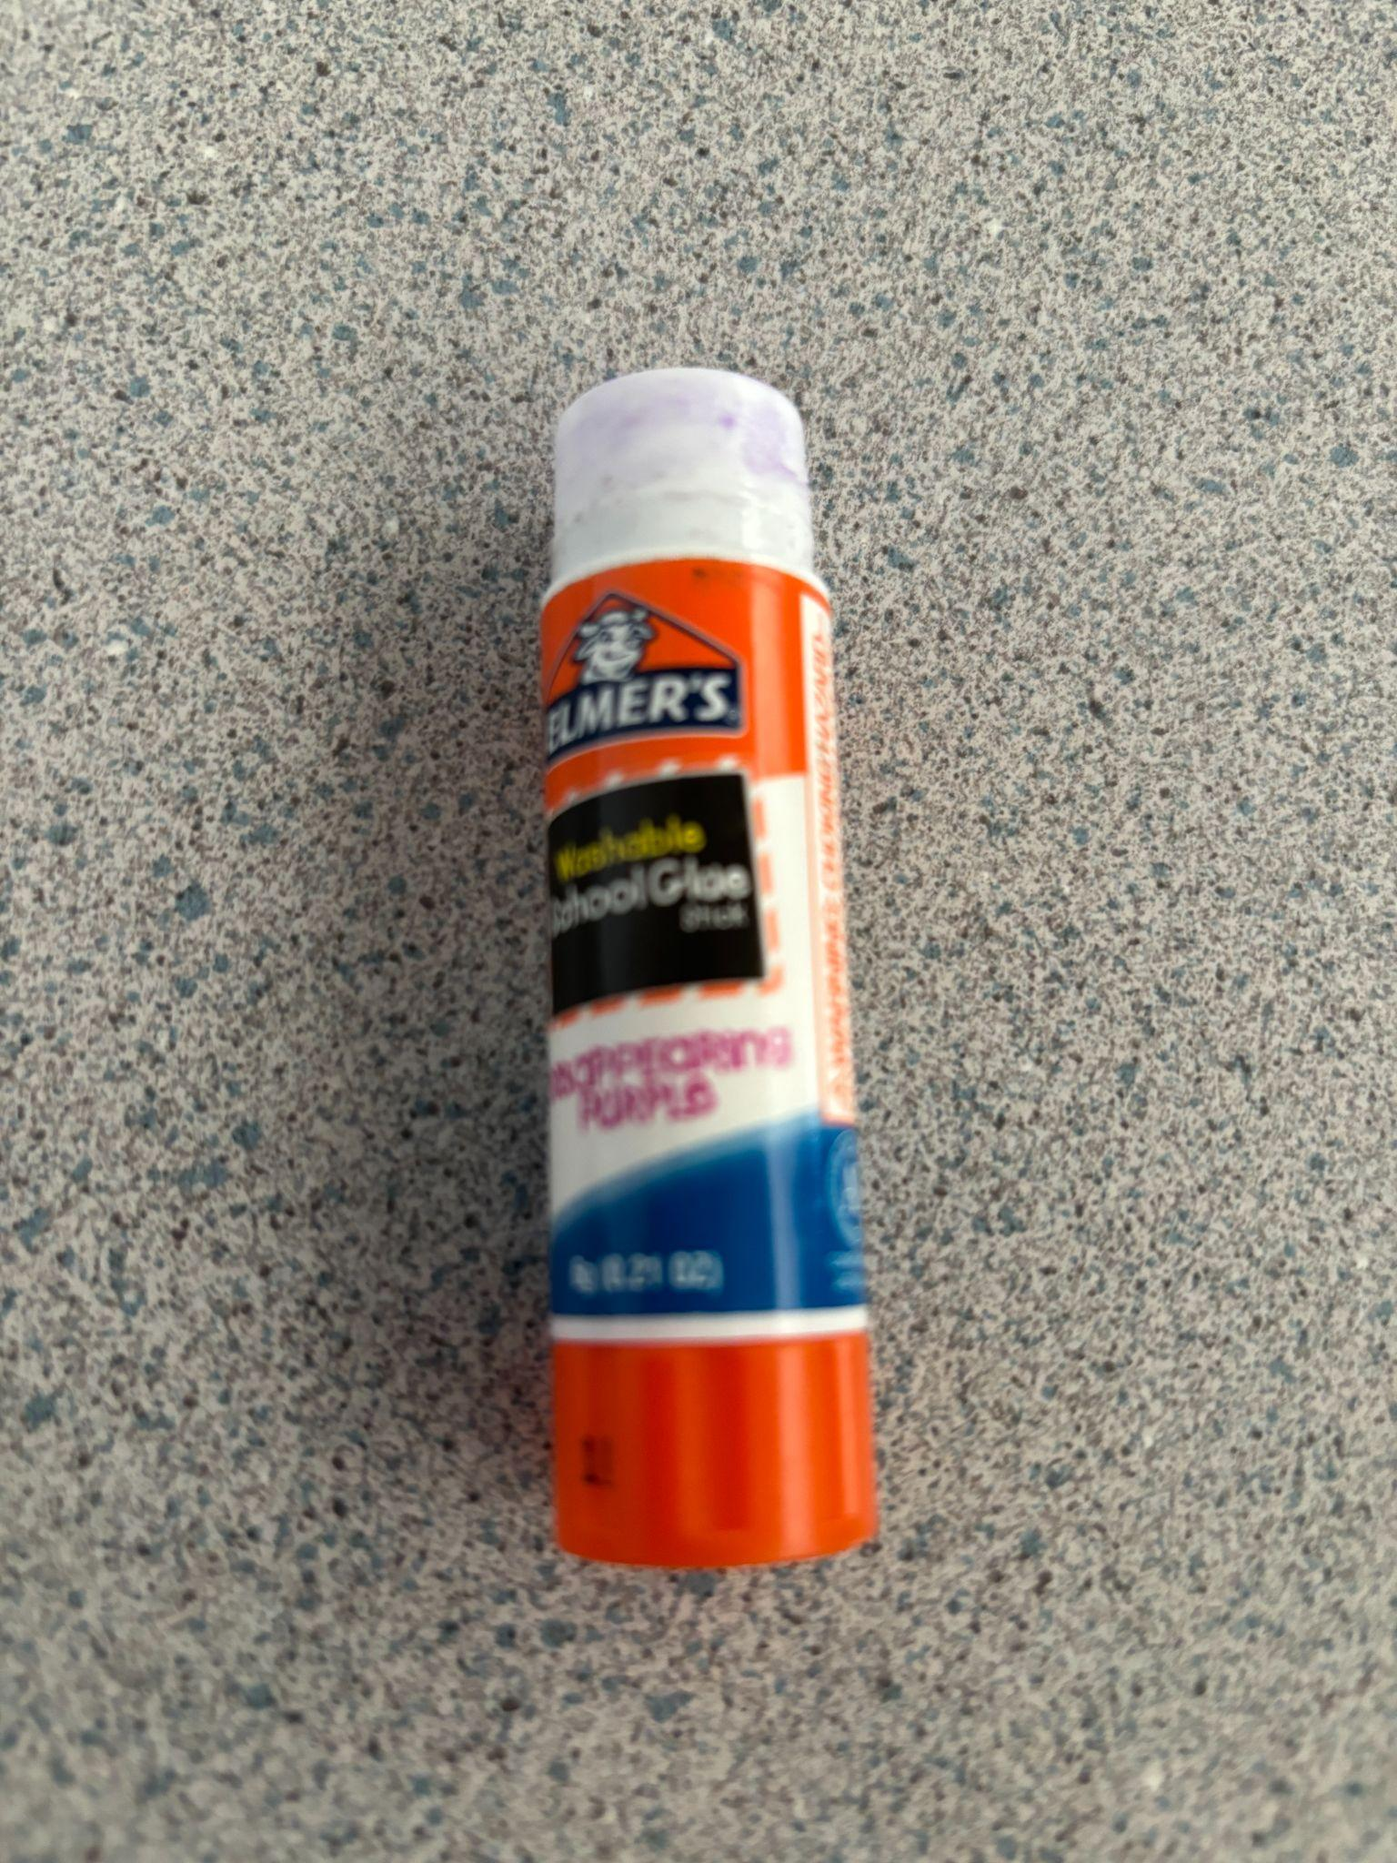
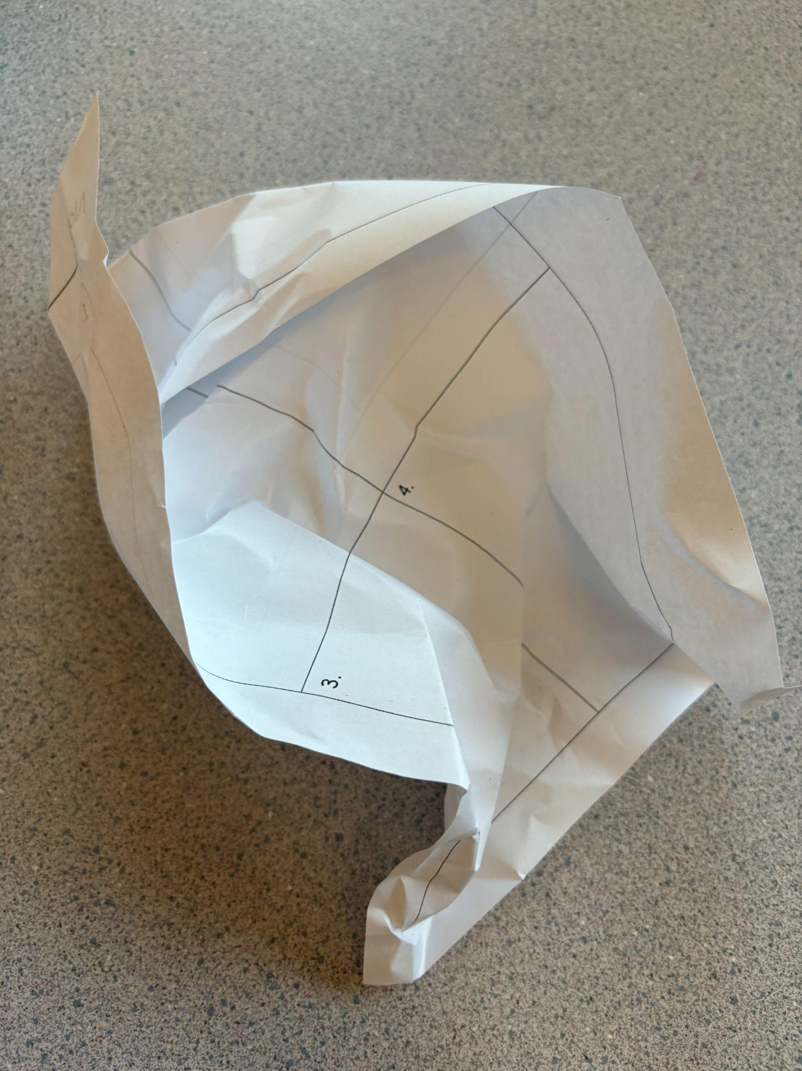
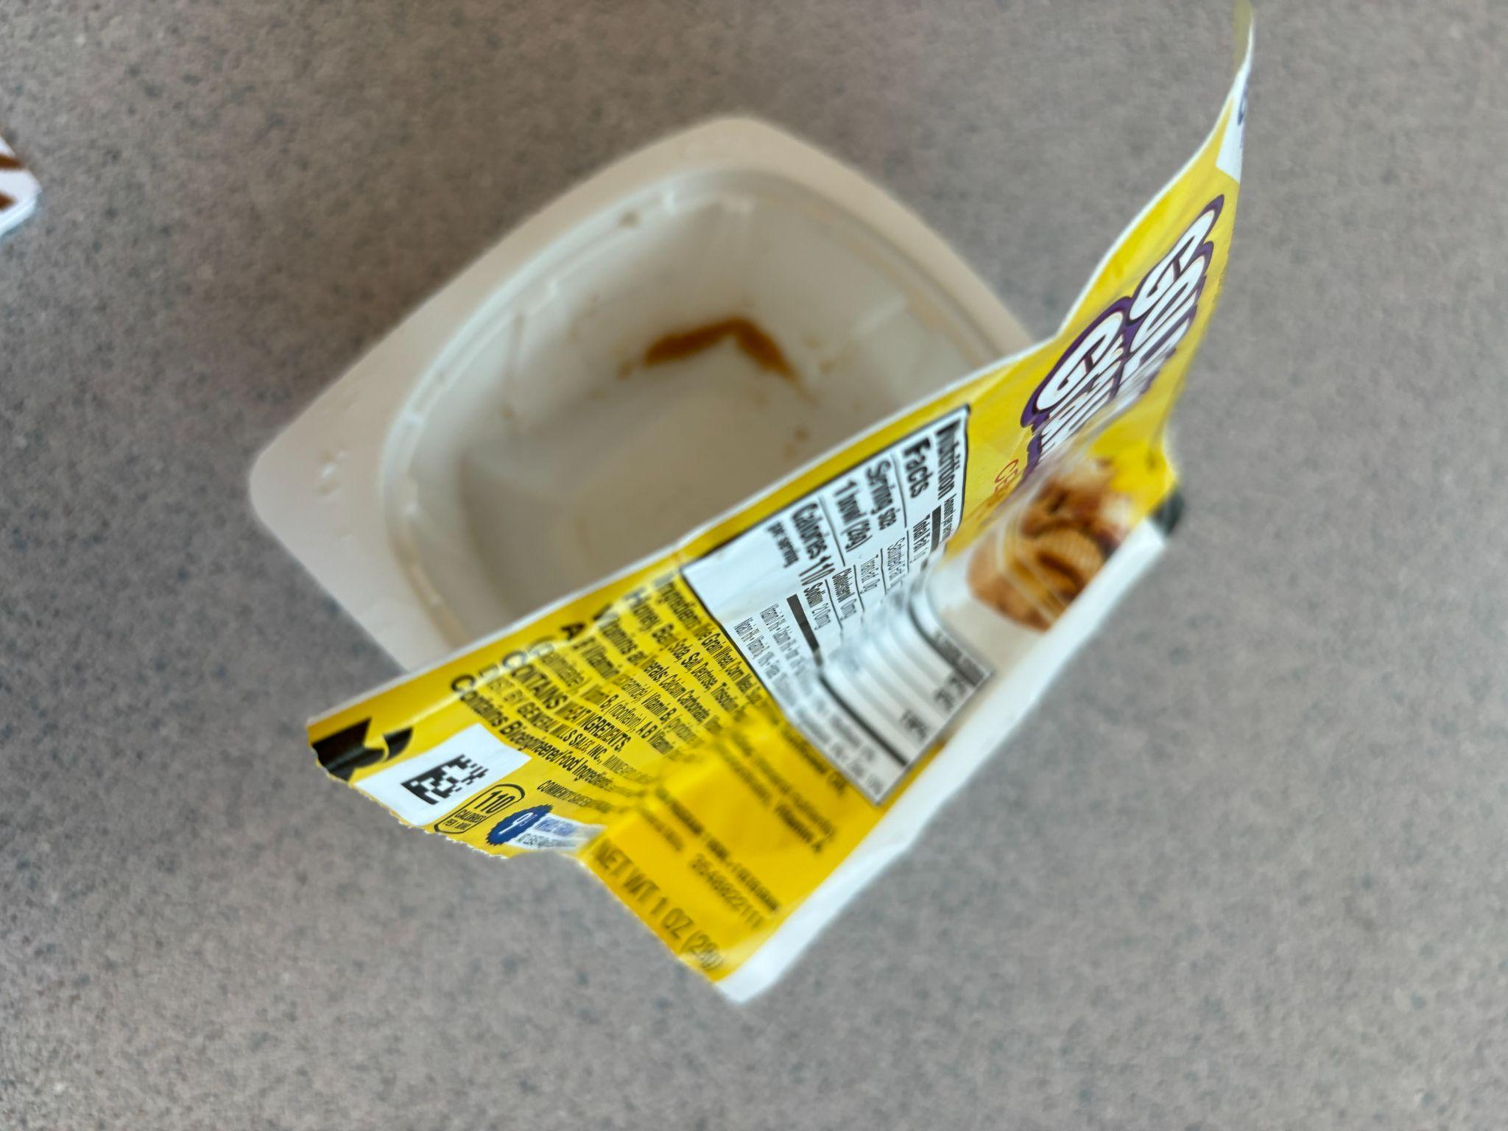
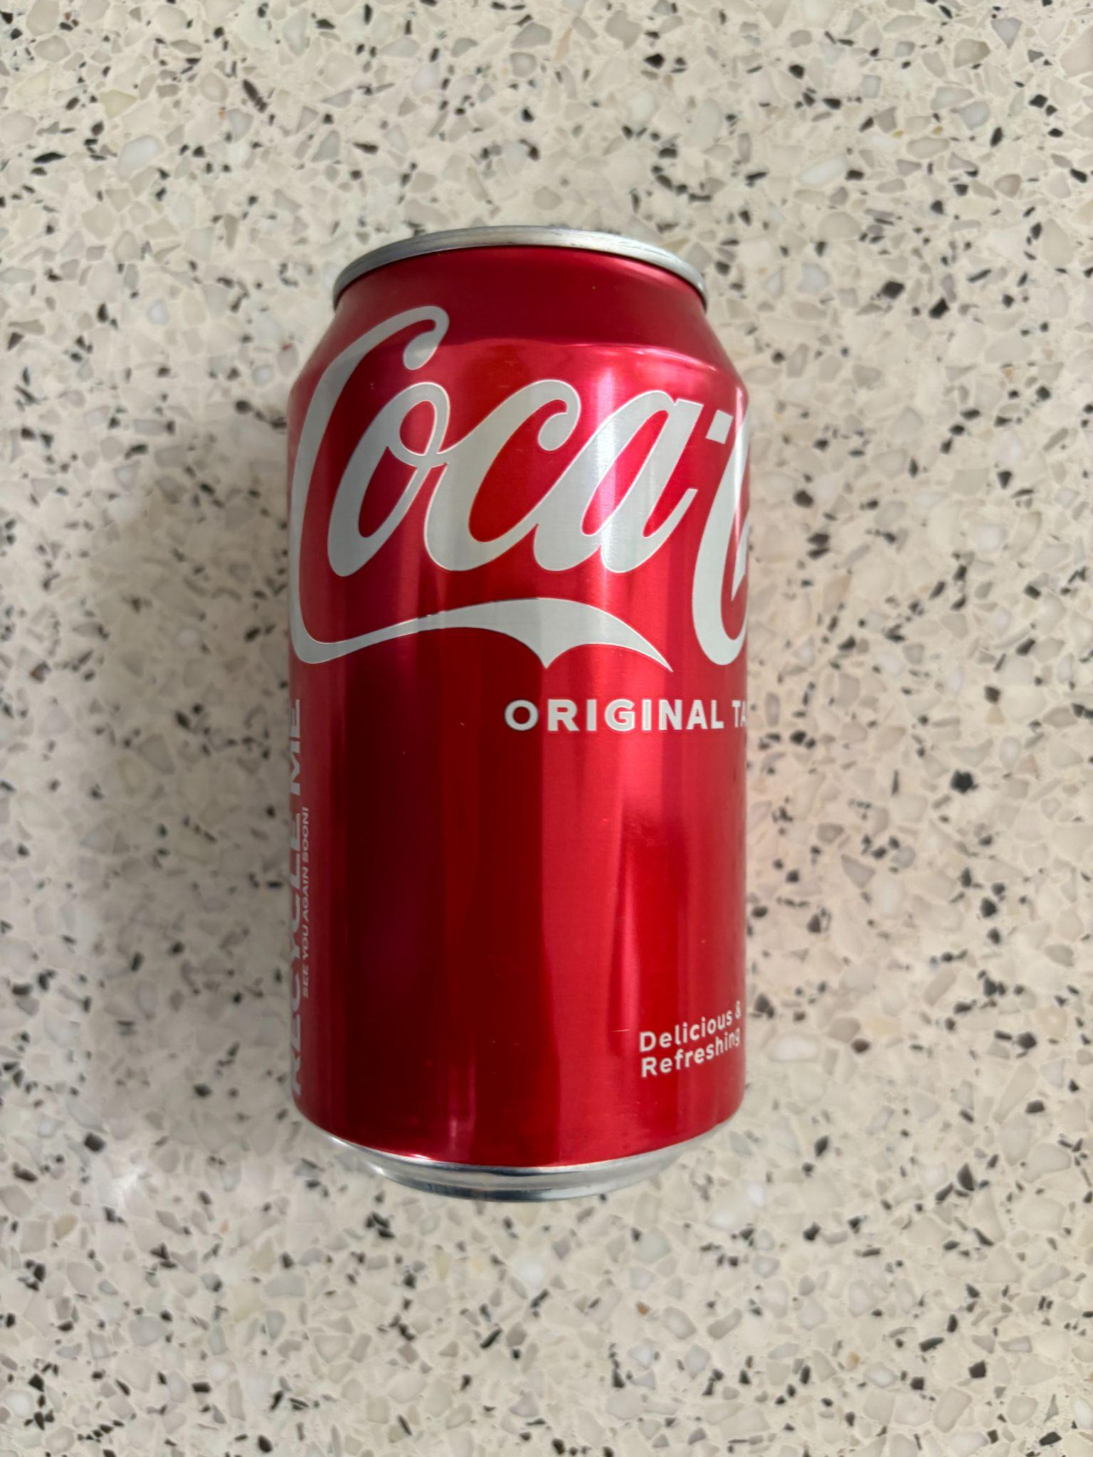
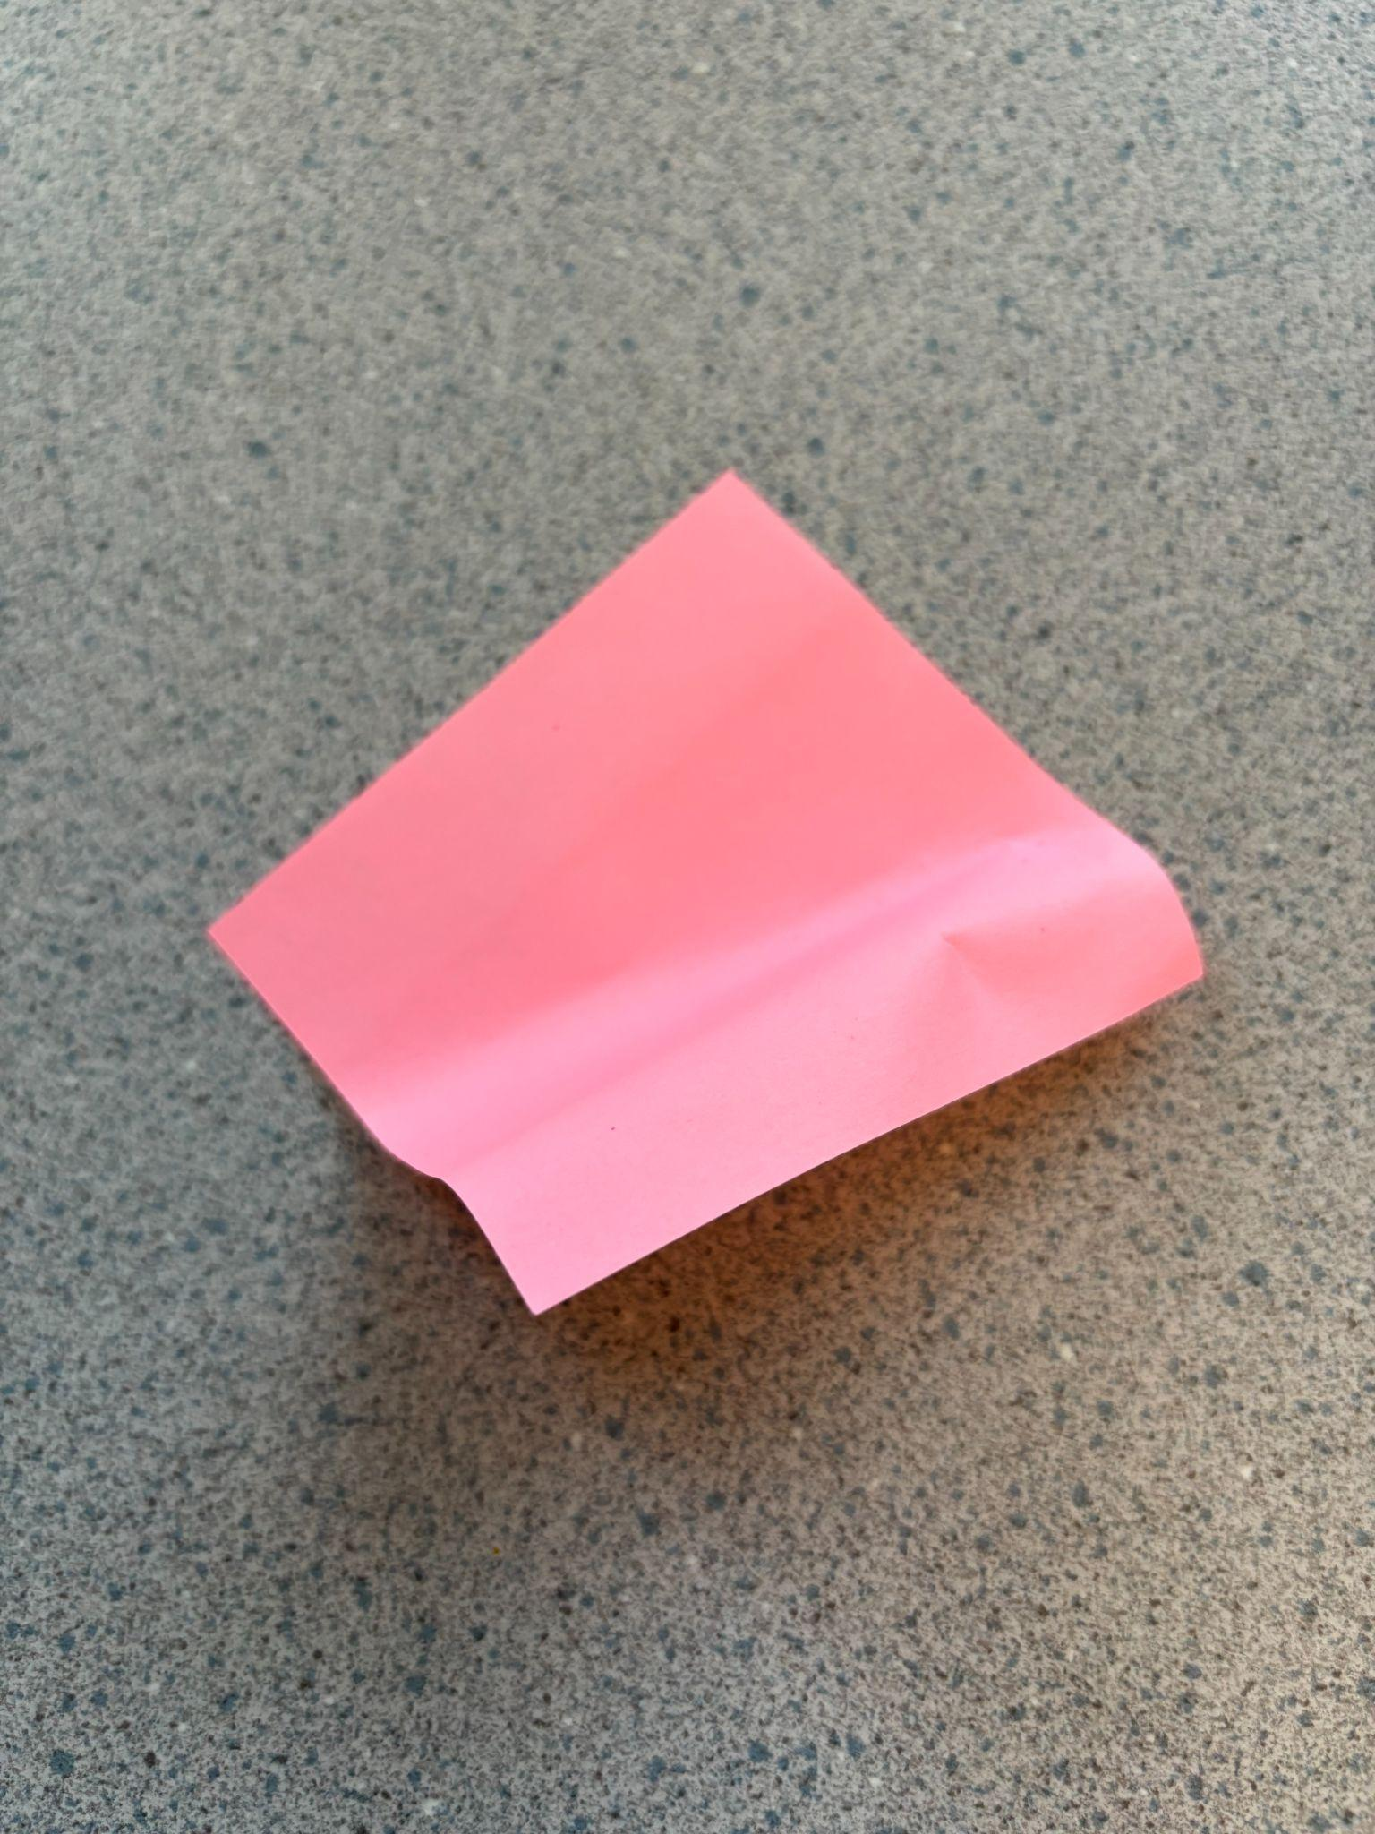
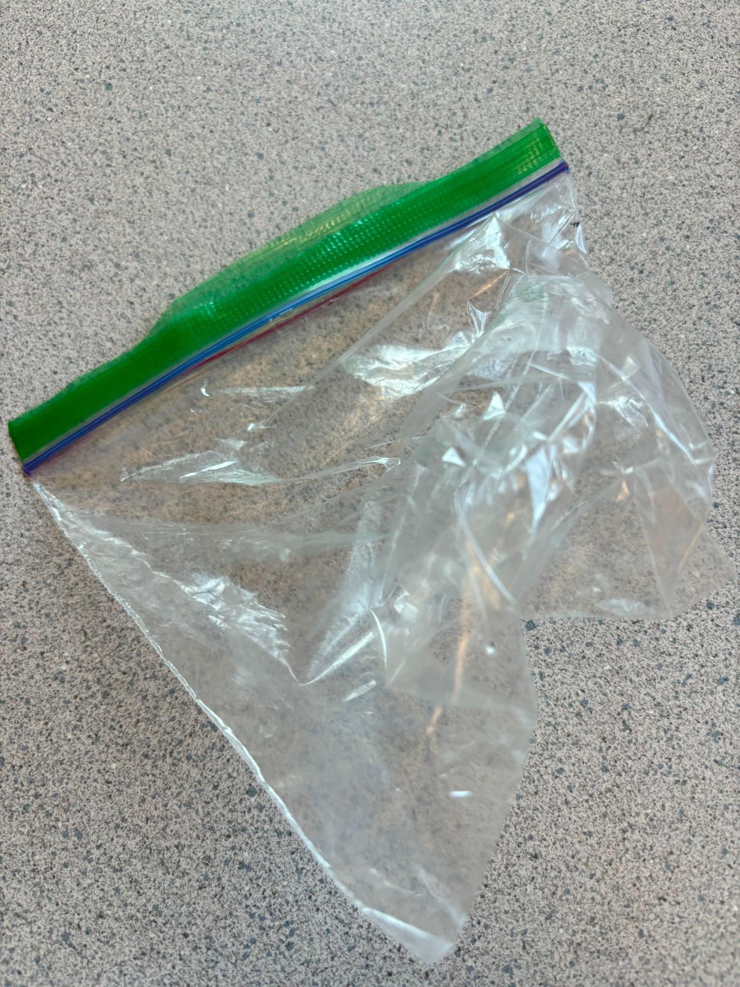
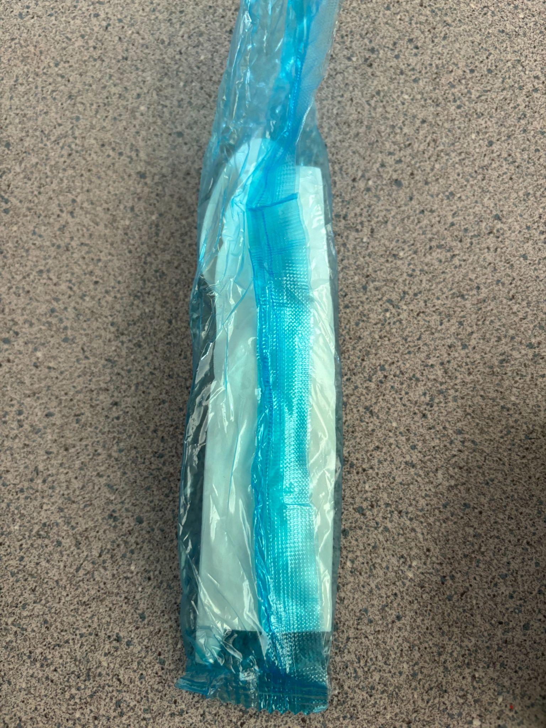
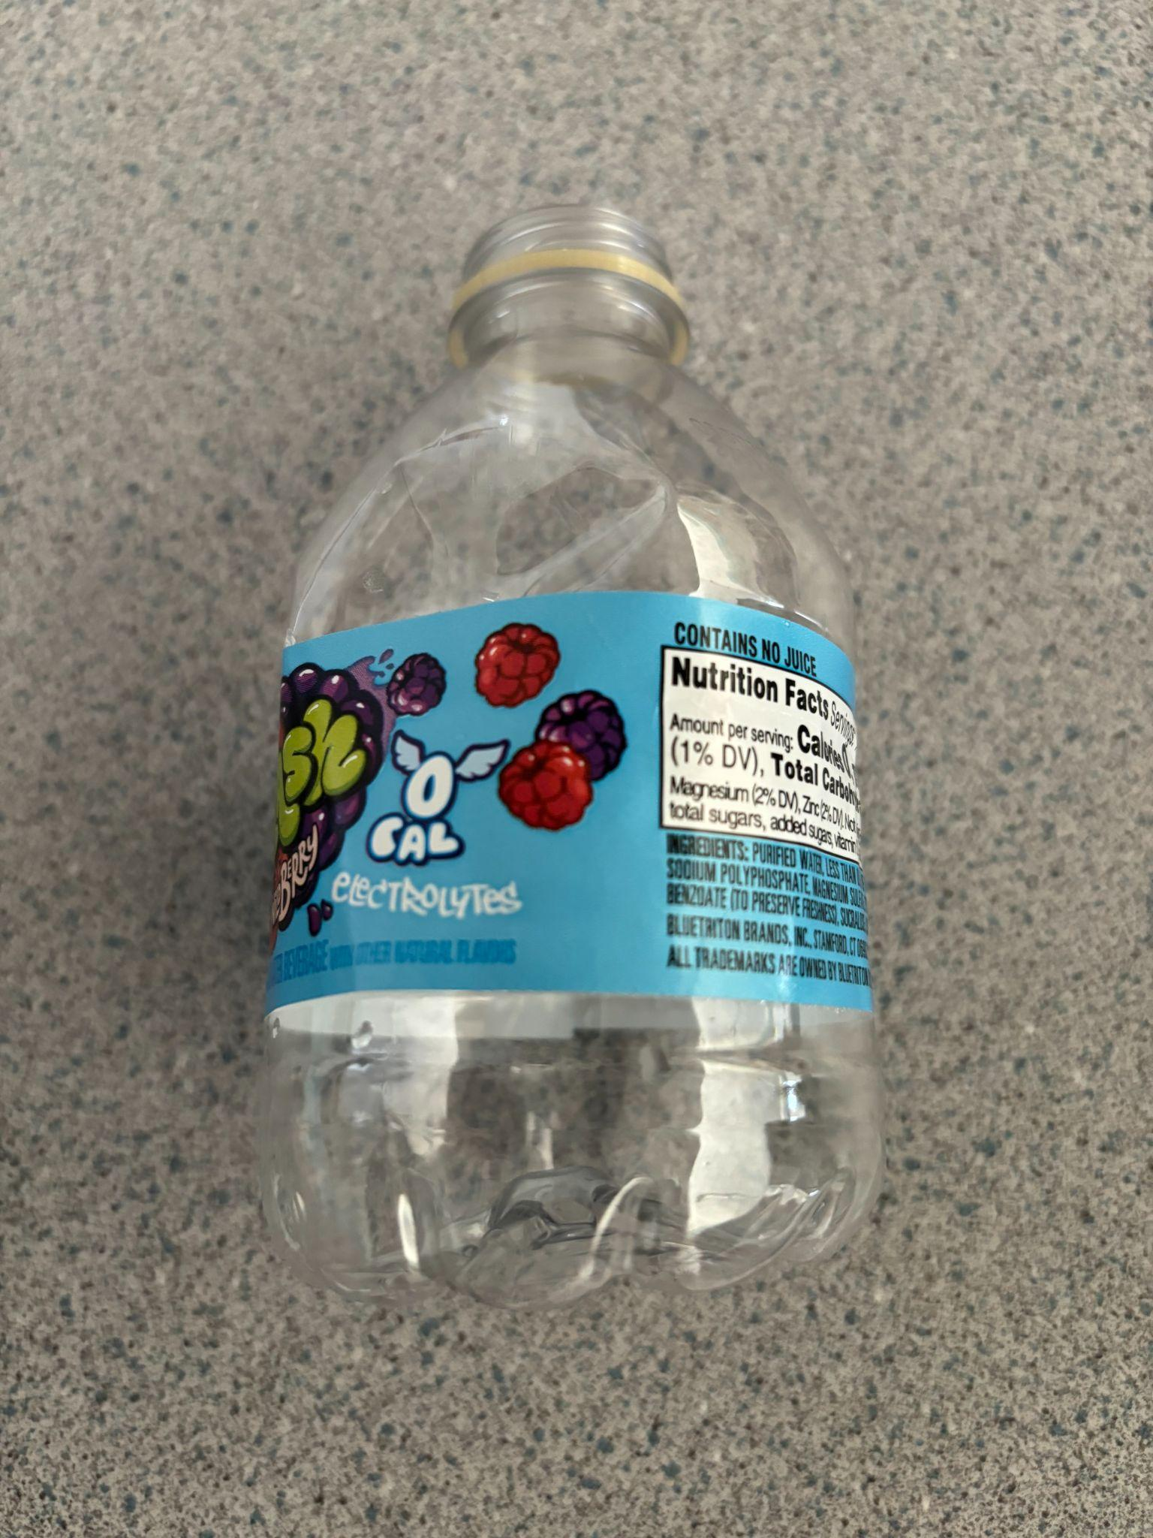

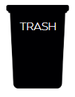
At TSES, we RECYCLE!
Talk as a class to decide what is OK and what is NOT OK to put in the TSES recycling bins.
The next slide will reveal the answers!

Slide 10
At TSES, we RECYCLE!
Only paper should go in the recycling bin!
How did you do? See next 2 slides for a few more ideas.

Slide 11
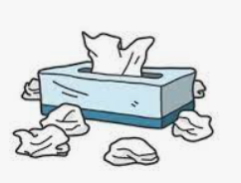
At TSES, we RECYCLE!
Only paper should go in the recycling bin!
What about USED TISSUES?

Slide 12
At TSES, we RECYCLE!
Only paper should go in the recycling bin!
What about USED TISSUES?

Slide 13
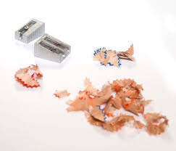
At TSES, we RECYCLE!
Only paper should go in the recycling bin!
What about pencil shavings?

Slide 14
At TSES, we RECYCLE!
Only paper should go in the recycling bin!
What about pencil shavings?

Slide 15
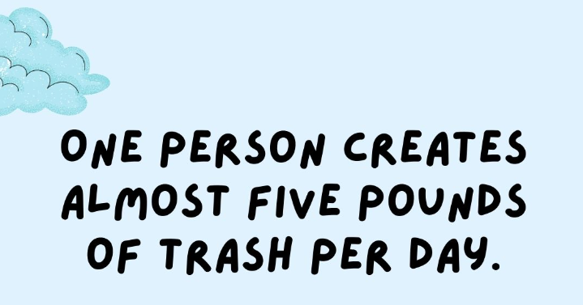
Fact of the Day!

Slide 16
Question of the Day!
Answer the question of the day with your class! All classes that submit an answer will be entered into a drawing for a fabulous Earth Day Prize!
DAY 2: Does your class commit to follow the TSES recycling guidelines?
Click here to record your answer!
Notes:
Discuss and record your answer here
https://docs.google.com/forms/d/e/1FAIpQLScXoR2Sm7iCECSig0cSAzFla7N-eM-ckIppSDcq56XU7g6fxg/viewform?usp=sf_link

Slide 17


Slide 18

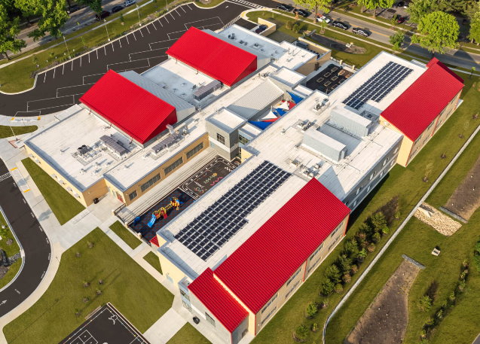
Did you know that TSES has solar panels on our roof?
What do you think they are used for?

Slide 19

Notes:
Video 1:58
https://youtu.be/GzQmo_Wd2Sw

Slide 20
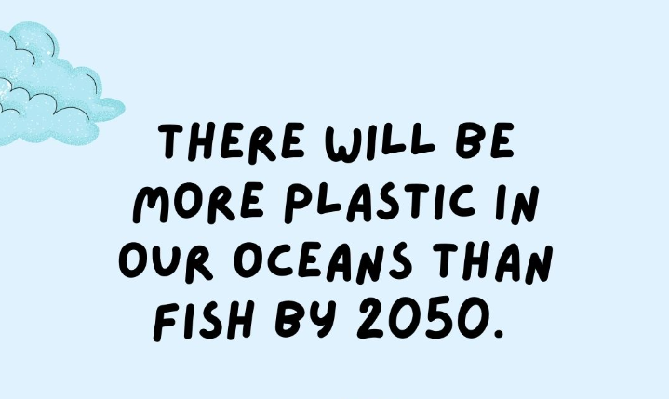
Fact of the Day!
Scientists Are Exploring the Idea of Building Solar Power Stations in Space!

Slide 21
Question of the Day!
Answer the question of the day with your class! All classes that submit an answer will receive Earth Day stickers!
Day 3:
What’s the most abundant energy source?
Click here to record your answer!
Notes:
Discuss your answer and record at https://docs.google.com/forms/d/e/1FAIpQLSfcSQsEO9Z1n-izbJNuq1SCxTtn33CSdTjt3wk8a2-I5k6YSg/viewform?usp=sf_link

Slide 22


Slide 23

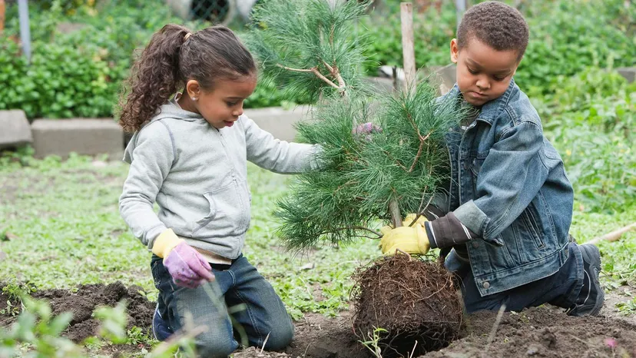

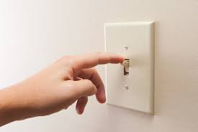
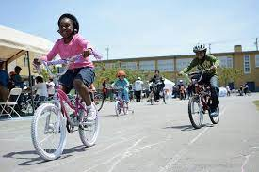
How can you save electricity?
Click on each image for some ideas!

Slide 24
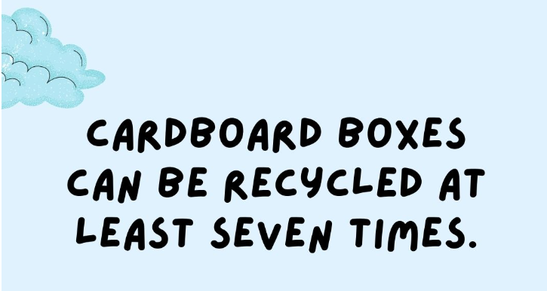
Fact of the Day!

Slide 25
Question of the Day!
Answer the question of the day with your class! All classes that submit an answer will receive Earth Day stickers!
Day 4:
Does your class commit to turn off the lights each time you leave the classroom?
Click here to record your answer!
Notes:
Discuss your answer and record at https://docs.google.com/forms/d/e/1FAIpQLSei7DLzj2BIeJ7iUGaWJPJBsuMY0RFPnUsci1dbP_SfLokkCw/viewform?usp=sf_link

Slide 26


Slide 27
Fact of the Day!

Slide 28

Do you know all the ways that TSES is helping our environment?
Go to the next slide to take a short quiz to show what you know about the ways TSES is trying to be Earth Friendly!

Slide 29
Question of the Day!
Answer the question of the day with your class! All classes that submit an answer will receive Earth Day stickers!
Day 5:
Do you know what TSES does to be Earth Friendly?
Do you have any ideas to help us become MORE Earth Friendly?
Click here to record your answer!
Notes:
Discuss your answer and record at https://docs.google.com/forms/d/e/1FAIpQLSd4WCCnFvX2A_j5ZjlTAQDnbineri1wjejZjGkhRVLg3jjyAA/viewform?usp=sf_link

Slide 30



BONUS ACTIVITIES
Song - Primary Grades
Earth Day Freeze Dance #1
Earth Day Freeze Dance #2
Notes:
Primary Song
Brain Break - Earth Day Freeze Dance #1
Brain Break - Earth Day Freeze Dance #2

